Slide 1
Non-Linear Programming

Slide 2
Google Colab
If you are using
https://colab.research.google.com
Please install CVXOPT and CVXPY
Just type (in the notebook on Colab)
!pip install cvxopt
!pip install cvxpy

Slide 3
Business Trivia
What are the differences between:
Fixed costs vs. variable costs
Economies of scale vs. Economies of scope

Slide 4
Agenda
Non-Linear Programming
Some theoretical elements
Pricing strategy
Portfolio Optimization
Recall from Last Week: Online Retailing

Slide 5
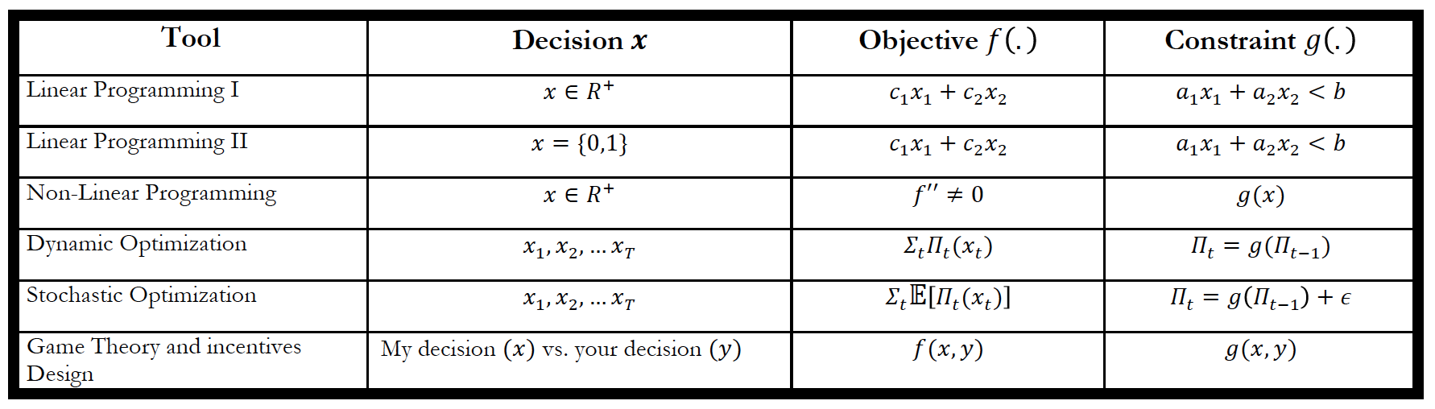
Non Linear Programming

Slide 6
Linear vs Non-Linear Optimization
Important assumptions behind linear optimization
Constant return to scale
No interactions between decision variables
No threshold effects
In many situations these assumptions are violated
Non constant marginal returns
Interactions effects
Threshold effects
Solution: Non-Linear optimization
I sill rely on the idea of convexity

Slide 7
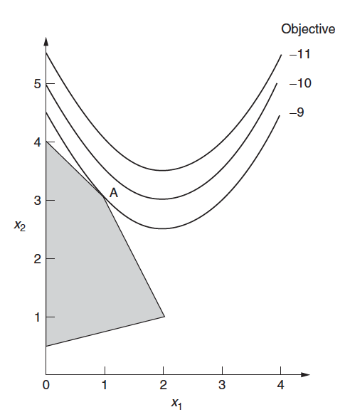
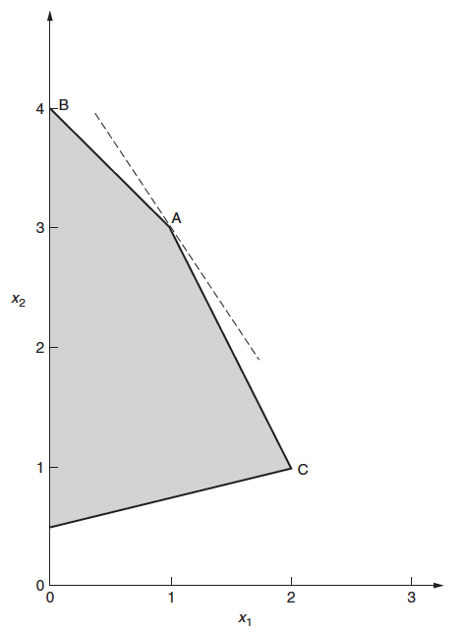
Visually

Slide 8
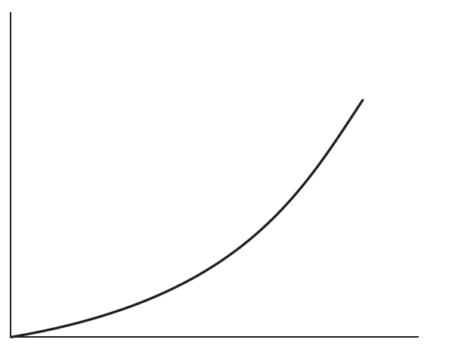
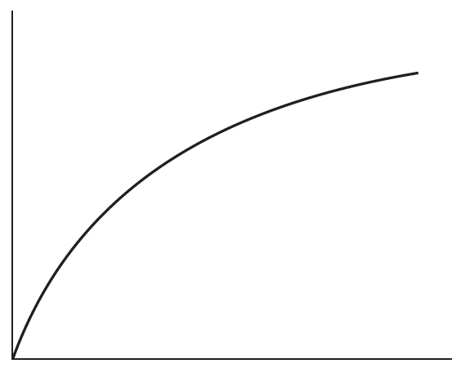
Non Linear Effects

Slide 9
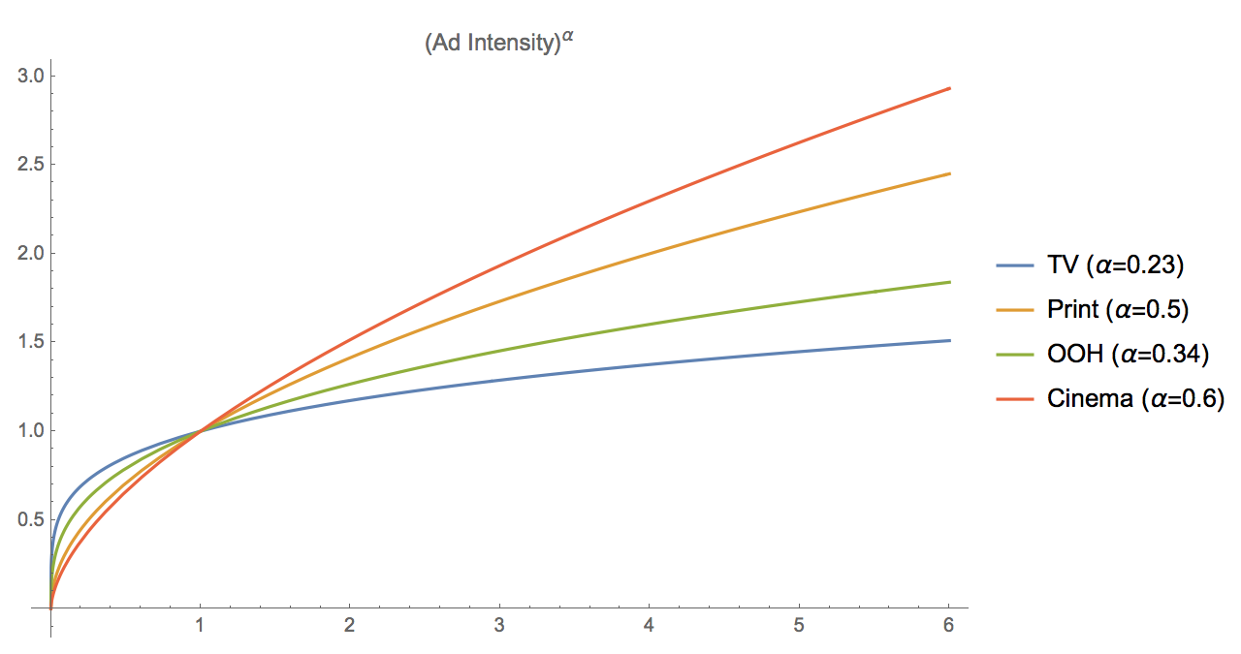
Advertising Marginal Decreasing Returns

Slide 10
Remember Cobb-Douglas from Prasad’s Class

Slide 11
Optimality Conditions: Unconstrained Problems

Slide 12
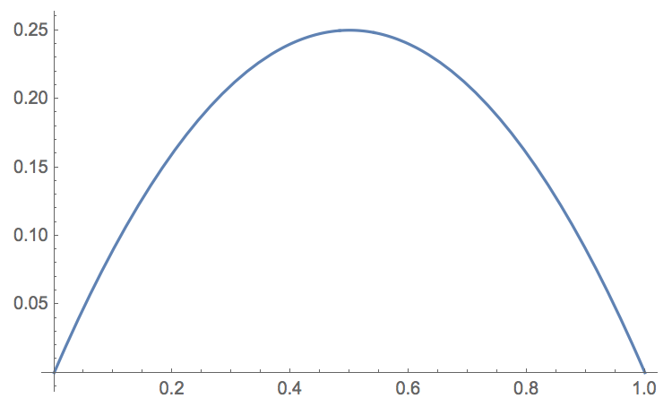
Pricing

Slide 13
Willingness-to-Pay (WTP)
Price response functions clearly arise as a result of customer behavior and in particular customers’ willingness-to-pay. We need to make assumptions to model the impact of price on demand
Given a market of size M, we assume that potential customers each have a maximum willingness to pay for a product of w(p)
The WTP of a given customer could be higher or lower than the market price
The WTP has a known probability distribution
What is captured by the notion of probability distribution here?

Slide 14
Probability Distribution?
The WTP’s probability density function can come from survey data (e.g., conjoint analysis)
It can also be estimated from market data given some assumptions
We will see that later
For now, we will assume that

Slide 15
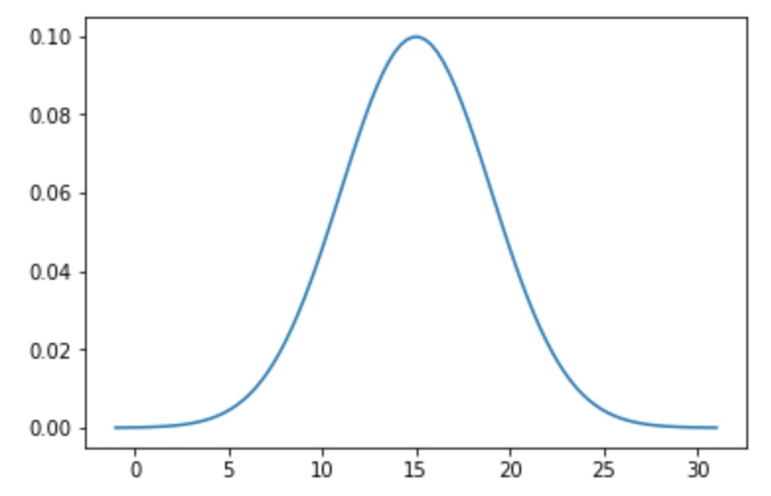
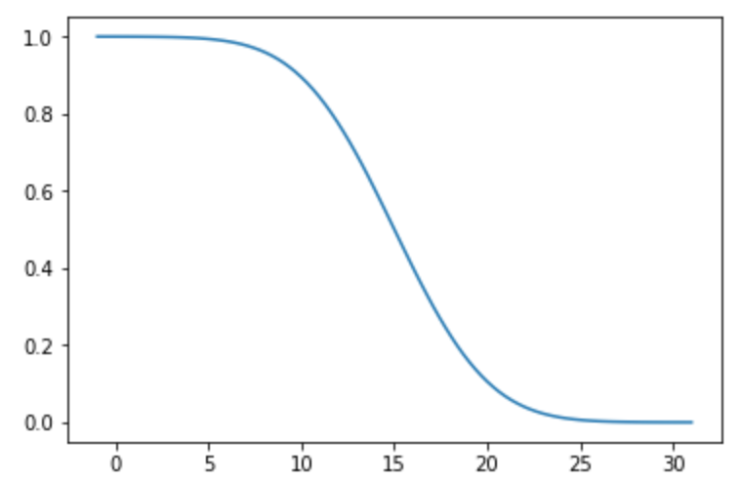
Normal Willingness-to-Pay Distribution

Slide 16
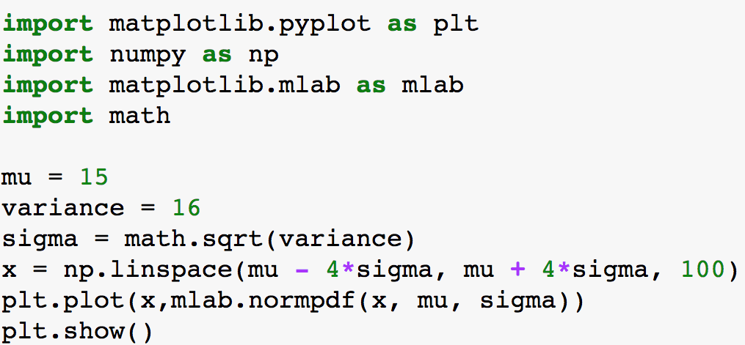
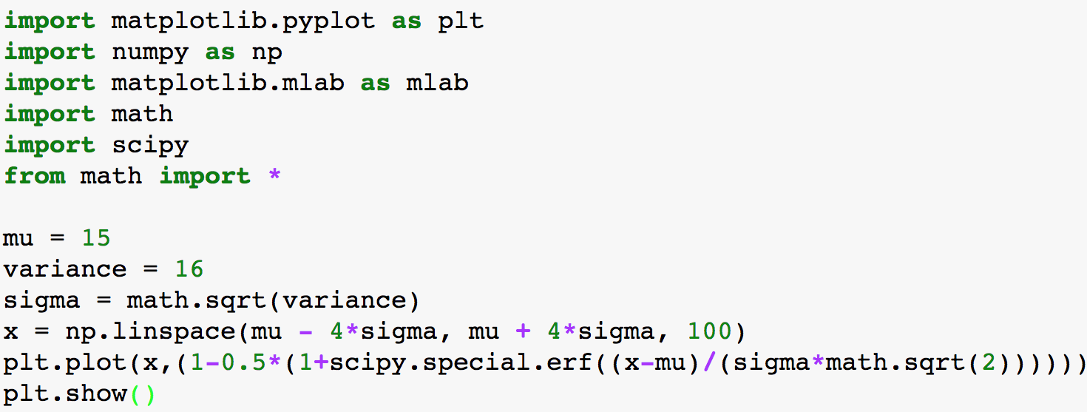
Codes for Figures

Slide 17
Formally

Slide 18
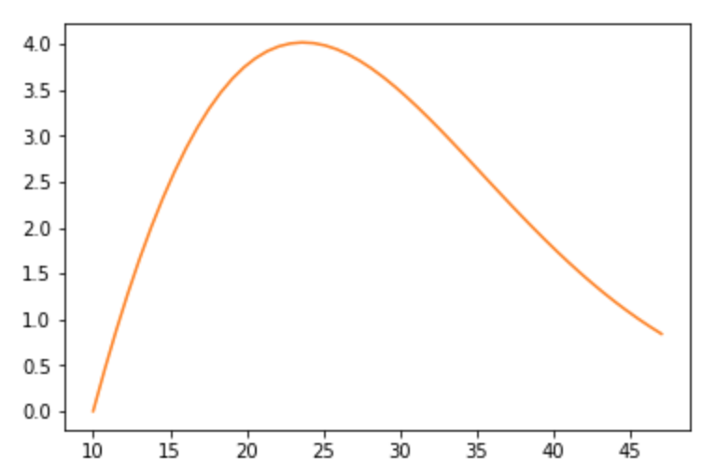
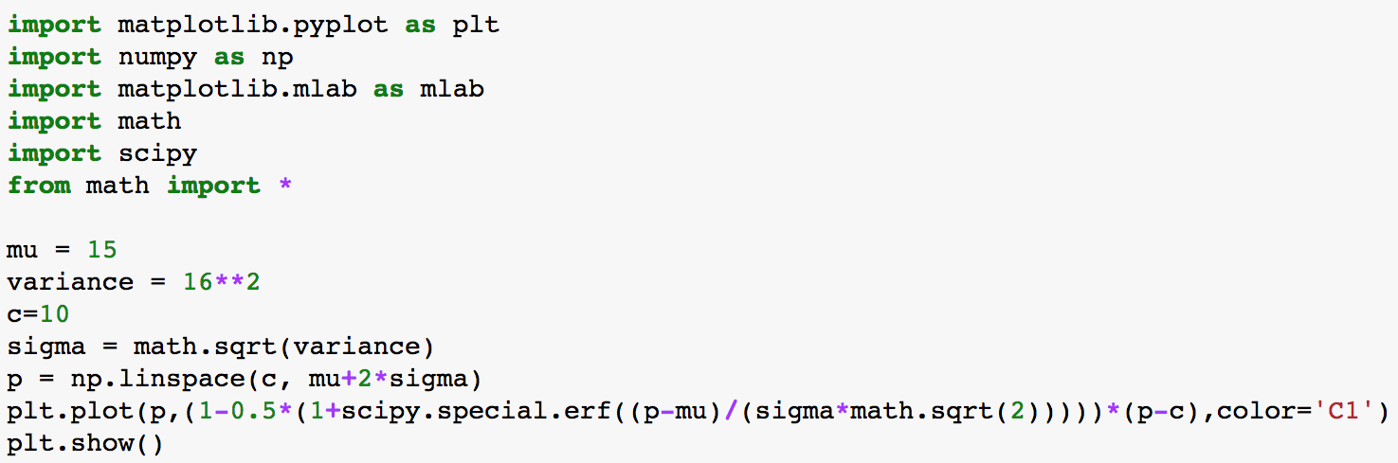
Profit Function under Probit Model

Slide 19
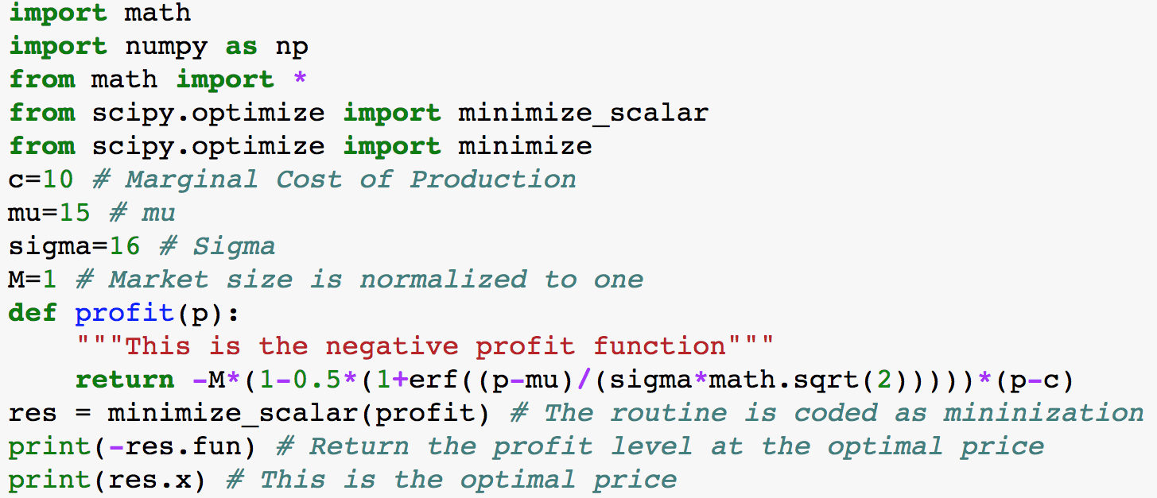
Optimal Price

Slide 20
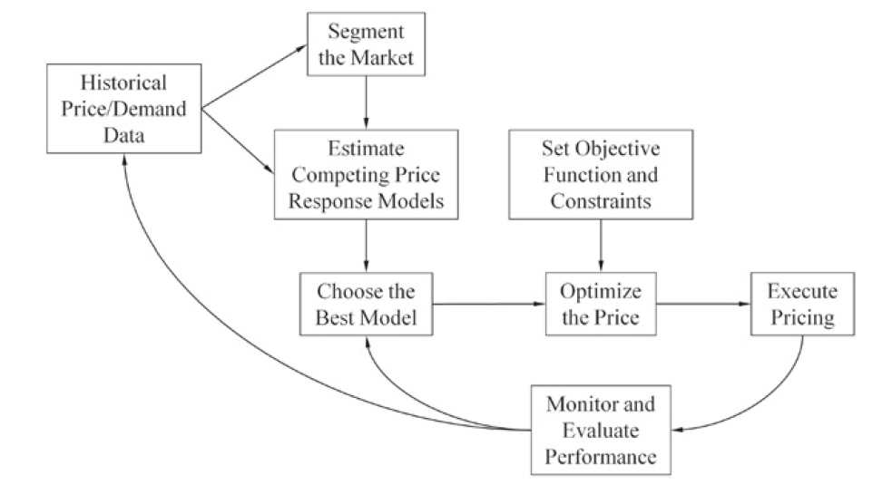
Recall: Pricing Analytics Process
Notes:
From Bodea and Ferguson “The Theory of Pricing Analytics”

Slide 21
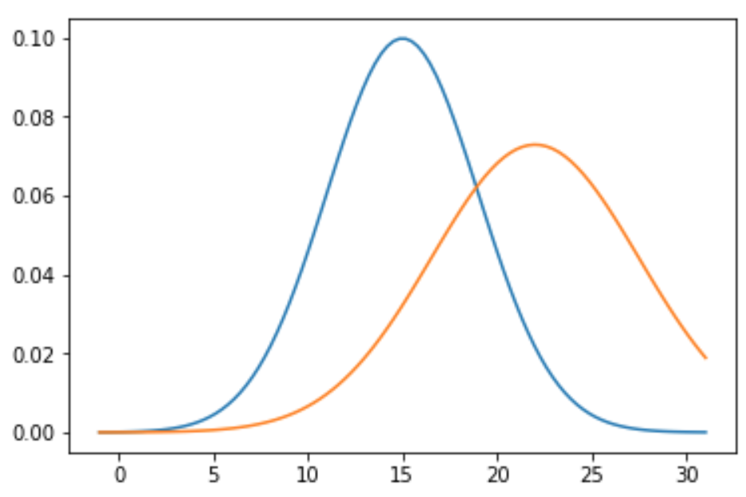
Pricing with Two Segments

Slide 22
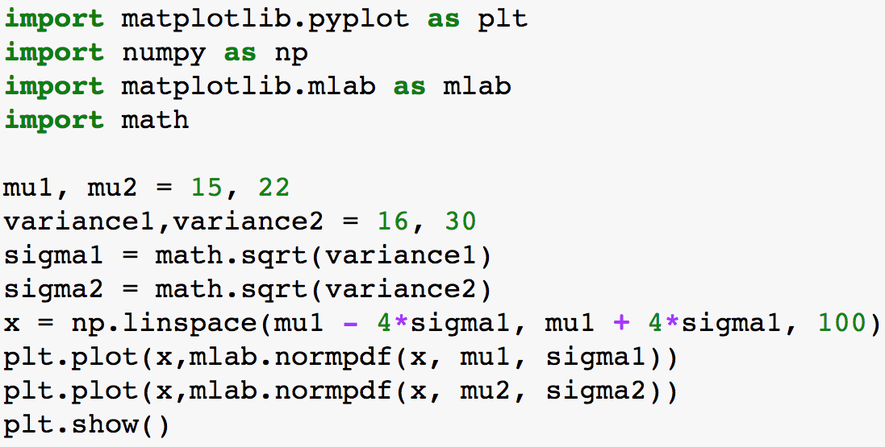
Code for Previous Figure

Slide 23
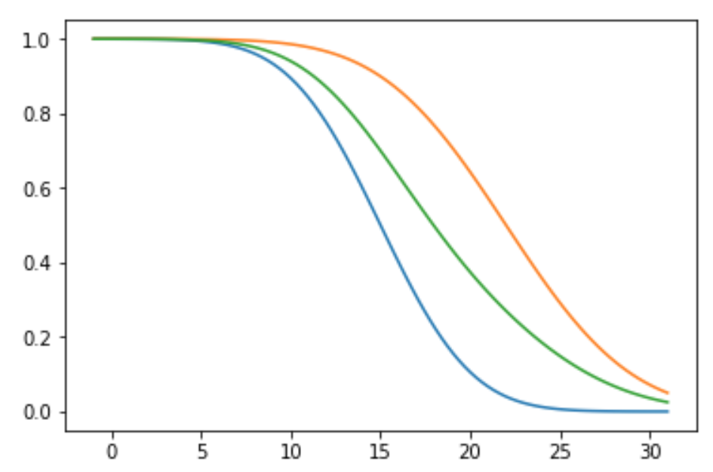
Demand Functions

Slide 24
Optimal Price with Two Segments

Slide 25
Optimal Prices with Two Segment

Slide 26
What are we doing?
Having different prices for different segments
What is the name of this practice?
How would you implement that in practice?

Slide 27
Price …
Table for sensitivity analysis to be created during class

Slide 28
Implementation
Price discrimination is profitable, but profit improvements depend on the level of heterogeneity in the market
How would you implement that in practice?

Slide 29
From Utility to Probit Models

Slide 30
Probit Estimation

Slide 31
Other Applications
We modeled a discrete choice and investigated how this would drive price decision
You can make the model more richer (more complicated) by
Including more variables, e.g., advertising
Other type of decision, e.g., donation, signing-up
Having more than one choice, e.g., multi brand models
Enriching the behavior, e.g., make it dynamic

Slide 32
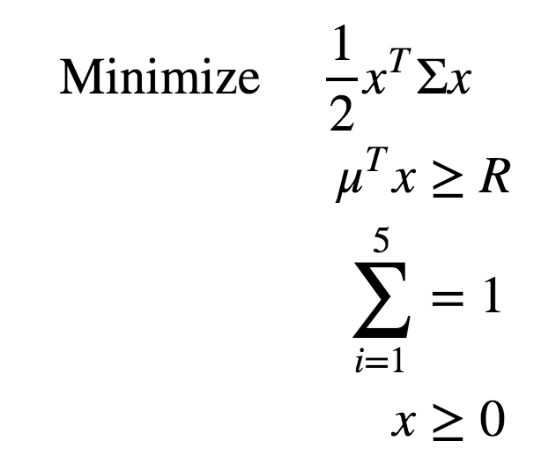
Portfolio Optimization

Slide 33
Algorithms
Look at chapters 9 to 11 in Convex Optimization by Boyd and Vandenberghe

Slide 34
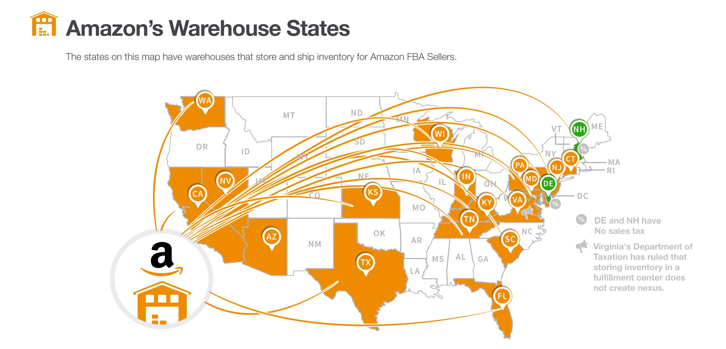
Amazon
In the last few years, due to the expansion of the services such as Amazon Prime and Amazon Prime Now, the importance of effectively selecting the location of new warehouses and/or choosing the right local warehouse to work with has dramatically increased

Slide 35
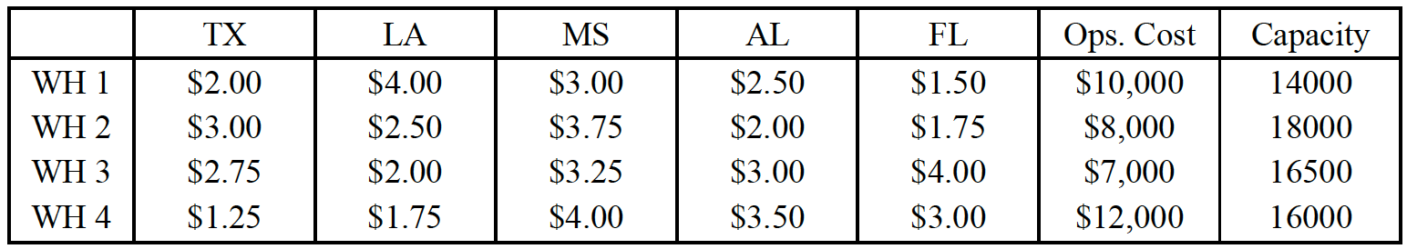
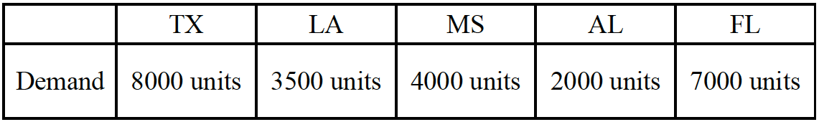
Because of the emerging demand, Amazon decided to start new warehouses in the Gulf Coast. Based on their studies, four potential locations for warehouses have been identified, each of which having a specific capacity and also a specific average cost-per-unit for shipping to any of the five Gulf Coast states. The capacity of each warehouse and its operating cost, in addition to the average cost-per-unit for shipping a product to any of the states are given in below, as well as demand from each state.

Slide 36

Questions
What is the minimal total cost for Amazon’s supply chain?
Which warehouses should Amazon operate?

Slide 37
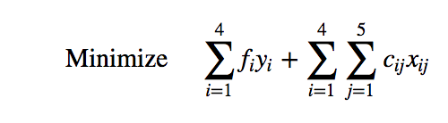
Objective Function
So what’s the solution?

Slide 38
Next
Duality
Optimality conditions with constraints

